Slide 1


Slide 2
BACKGROUND
In these days' organizations are more vulnerable to outside and inside cyber-attacks, leaks and exploits. Most organizations are not ready to handle a cyber-attack. For example, a bug in the system can leave access to valuable information open for the public, or hackers hack into the system and acquire personal information of clients and employees. Leaks can include personal data of existing and past clients, which makes the organization uncredible for new clients. Some of the threats are not always well known and exposed to the public, and some organizations even try to cover-up their vulnerabilities, in the purpose of hiding it from their clients or potential clients and business partners. In some cases, the organization may not prioritize or capable of fixing the vulnerability, leaving it open for repeating attacks.

Slide 3
TARGETS
Since cyber-attacks are a lot more common than what people think and can occur in wide variety of products, it's easy to lose track of all of them. People sometimes don't fully know all of the cyber-attacks that occur against their products. Our project is designed to help people in this kind of situations.
Our project condenses the latest news about cyber-attacks on organizations, using a simple interface that allows to search for an organization name. Only registered users can access the tool. Our goal is to help clients stay informed about all of the ongoing cyber-attacks that occur against the organizations they mainly consume from. With our tool, clients can look up any organization name and read about the latest data breaches and exploits that occur in the products they use.

Slide 4
PROJECT STRUCTURE
Usage | Library/Package/Language
Framework used to write, review and edit our code. | Visual Studio Code
The entire web application is written in JavaScript. | JavaScript
Handles the front-end; user interface. | React
Database for managing registered users. | MongoDB
Handles HTTP requests. | Axios
Used to scrap relevant articles from the web. | Python (BeautifulSoup)
Handles the back-end; server-side. | Node JS

Slide 5

IMPLEMENTATION
At first, we used Selenium library with BeautifulSoup to gather the relevant articles about the company cyber-attacks. Selenium was used to open browser process and to execute the search query automatically, while BeautifulSoup was used to scrape the webpage for the article. Each website was scraped in parallel to save processing time.
We decided to use articles from the best possible websites:
• Cybernews.com
• Threatpost.com
• Welivesecurity.com

Slide 6
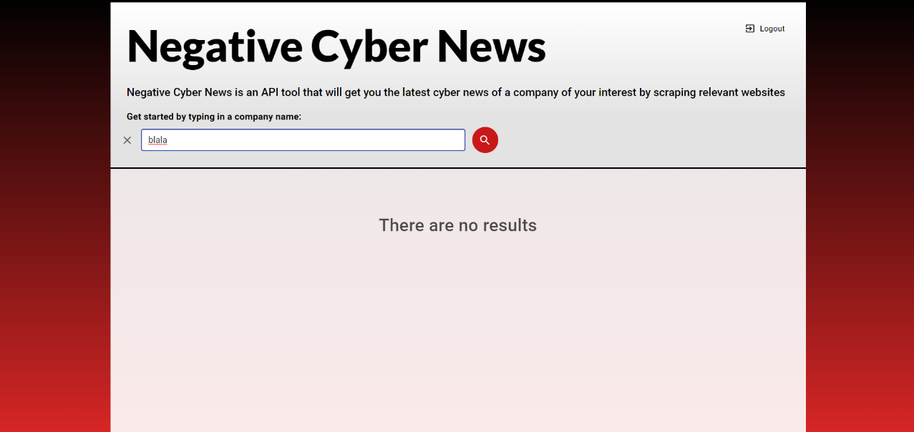
ISSUES
Scraping websites.
Some websites were problematic to scrape or showed nonrelevant results. For example, some website sometimes loaded up the most recent cyber news in general before displaying search results on the desired query. This proved difficult to scrape because it required to timeout the scraper until the relevant articles loaded up. In order to solve this issue, we decided to remove websites with this kind of problems and keep only the reliable websites for scraping.
Nonpersistent session.
The session between the user and the server remains open for several hours and only close when the user wants to log out or after the session time limit. We faced an issue that if a logged in user refreshed the webpage, it would log him out and close the session with the server. We managed to solve this by inserting the get user data method inside the render method.
Selenium.
Selenium is a Python package that used to perform automated tasks on webpages. We used Selenium to scrap webpages for articles. This proved to be inefficient and too slow. This was unacceptable and we had to replace Selenium. We eventually settled on BeautifulSoup package which is faster than Selenium. Unlike Selenium, BeautifulSoup is using HTML GET requests to acquire the needed data so it uses much less resources from the server. Now every search can take up to fifteen seconds to load, that’s over 60% improvement.

Slide 7
ALGORITHMS

Slide 8
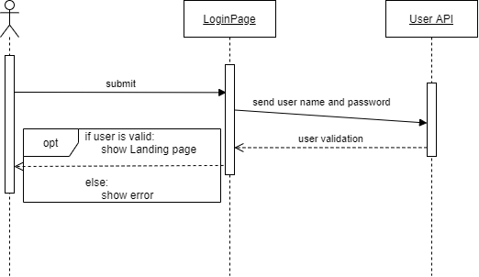
LOGIN
At first, the user sees the login page. He required to enter his username and password in order to log in to the website. After the user enters his username and password, he clicked on the log in button. The landing page component send a POST request with the user credentials to the user API. User API is the route that handle user authentication on the server side. After the POST request ha arrived to the user API, it sends the user credentials to "passport.js" package, which verify the user credentials with the DB.

Slide 9
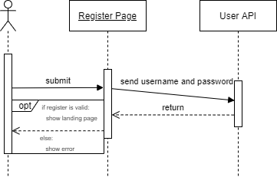
REGISTER
From the login page there is an option to register, after the user choose this option, he arrived to the register page. In the register page, the user is required to enter his desired username and password. After the user clicked on the register button, a POST request is sends from the register page component to the user API route. The API create a new user schema, and then send the new user schema to "passport.js" package. It checks if the user is already exists in the DB, if not it converts the user schema to an unique hash code and store it in the DB. If the register is valid, then the website redirect to the landing page.

Slide 10
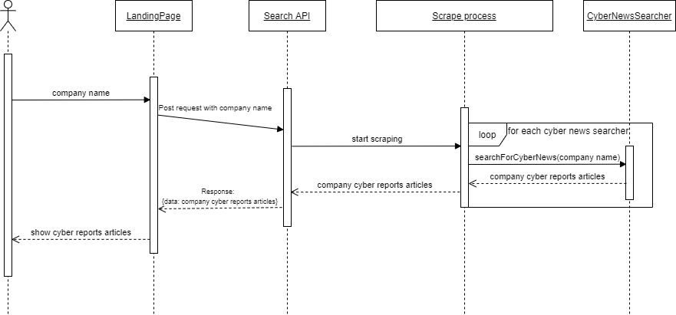
SEARCH
Once the user logs in, he is redirected to the landing page. There the user can make a search request (HTML GET request) with the desired company name. The request is being sent to the search API route with the user's input. The route activates a python script with the search term as an input. The python script is responsible for scraping the web and it's output is an array containing several articles from different cyber sites. The python process creates three classes, each class represents a cyber news website. Each class makes a search query in each website with the user input term, and keeps the source page of the search results. "BeautifulSoup" library then scraps the source code and extracts the latest articles from each website. Each class returns the articles to the process script, which creates a JSON format containing all of the returned articles. The search API returns a response to the landing page with the JSON articles and then shows them to the user.

Slide 11
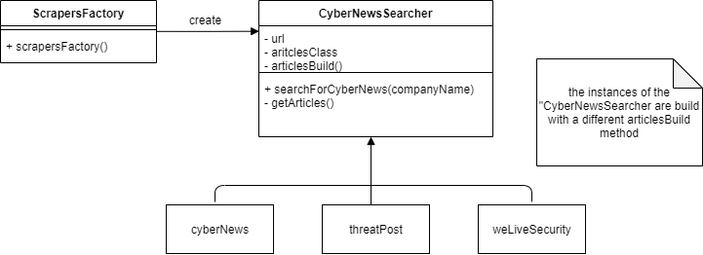
SCRAPING CLASSES
Each one of the scraping classes is created with factory design pattern. The creating function gets an ENUM that indicates which class to create. Then, it creates the appropriate class with the website URL, scraper parameters and method. Every class have a method that responsible to collect the articles, on each class this method uses a different strategy (strategy design pattern) to collect the articles, depending on the website.

Slide 12
PROJCET PRODUCTS
Server
The server handles the user authentication, the python scripts and the routing. It's a standalone API that responsible for sending data between the client and the database when logging in, registering or when there is an error in authentication. It is also responsible for sending user input, activating the scraping process and returning the results to the client.
Database
The database stores the registered users' credentials as a hash code. When registering, a new entry is added with the user's credentials as a hash code. When logging in, the user's credentials is compared with the stored hash codes, when there is a match, the user is allowed to log in, if there's not, the user receives an error accordingly.
Scripts
Scripts are used for scraping webpages and written in Python. All the websites are scraped in parallel, and the data is saved until the entire scraping process is finished. Then, the scraped data is combined into one object with a JSON format which returns to the server.
Client
The client handles all the user interface and displaying articles to the user. It is responsible for organizing the page layout and loading the proper design for each webpage. It is also responsible for sending the user input to the server and displaying any error it receives.

Slide 13
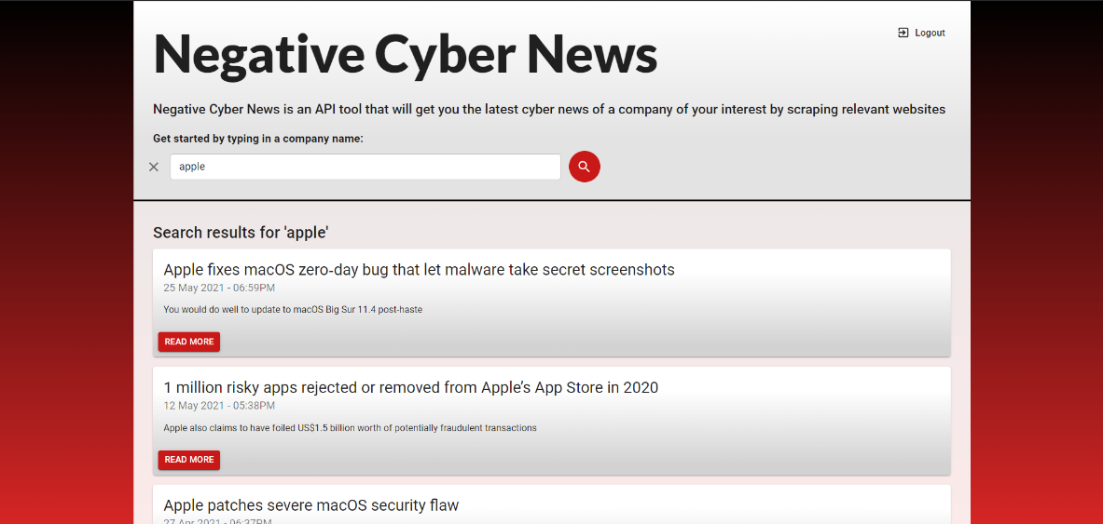
CONCLUSIONS
The end product of the project mostly did meet our expectations; therefore, we consider the project as a success.
Fully implemented user registration and authentication features, with database that stores the users' credentials.
Fast search engine that shows the latest and most relevant results.
Modern design to the website.
Fully implemented error handling and error presentation to the user.
Complete separation between client and server.

Slide 14
IDEAS FOR IMPROVEMENTS
An additional improvement possible for the application is to scrape a website or twitter page that displays the latest CVEs once a day and displaying them in the web in a new route.
Adding features that include machine learning to improve the search function.
Adding score to each result that indicates its credibility.

